Slide 1
A Machine Learning Approach to Develop an EMT Classifier
Walter F. Lenoir IV
Sanjana Srinivasan
Notes:
Darlan From GSBS

Slide 2
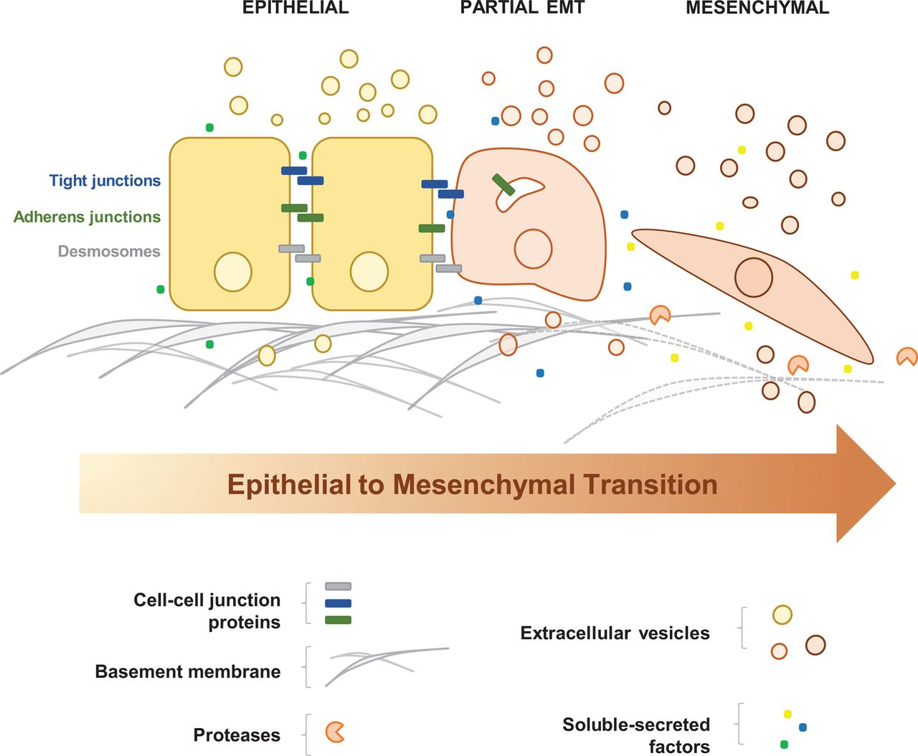
Epithelial to Mesenchymal Transition
Process by which epithelial cells lose cell polarity and adhesion and gain migratory and invasive properties that can differentiate into multiple cell types
Essential in processes like wound healing, but has also been observed in cancer progression and metastases
In cancer EMT is not a binary event, but rather occurs on a spectrum
Gopal, S.K., et al., Extracellular vesicles: their role in cancer biology and epithelial-mesenchymal transition. Biochem J, 2017. 474(1): p. 21-45.
Notes:
Sanjana

Slide 3
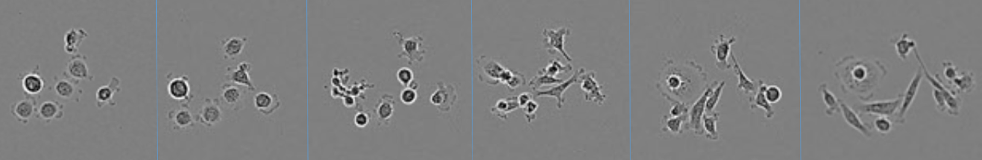
Current Classification Methods
Currently, initial classification to identify cell lines undergoing EMT is done by eye
Confirmation of EMT status is quantified through RNA-Seq
Expensive and inefficient
Pressing need to systematically assess degree of EMT
Can prioritize mesenchymal models of interest prior to sequencing
Mesenchymal cell lines can be scored on a spectrum based on stage of the transition
Notes:
Sanjana

Slide 4
Objective
Research is preclinical models of pancreatic cancer to identify subtype specific vulnerabilities
Compendium of internally generated patient derived cell lines at varying stages of EMT
Quantification of degree of EMT based on microscopy would save both time and money
We aim to develop a robust computational framework to identify and quantify the degree of EMT through image analysis of cell lines using tools from class and Matlab Machine Learning Apps to classify cells as Mesenchymal or Epithelial
Notes:
Sanjana

Slide 5
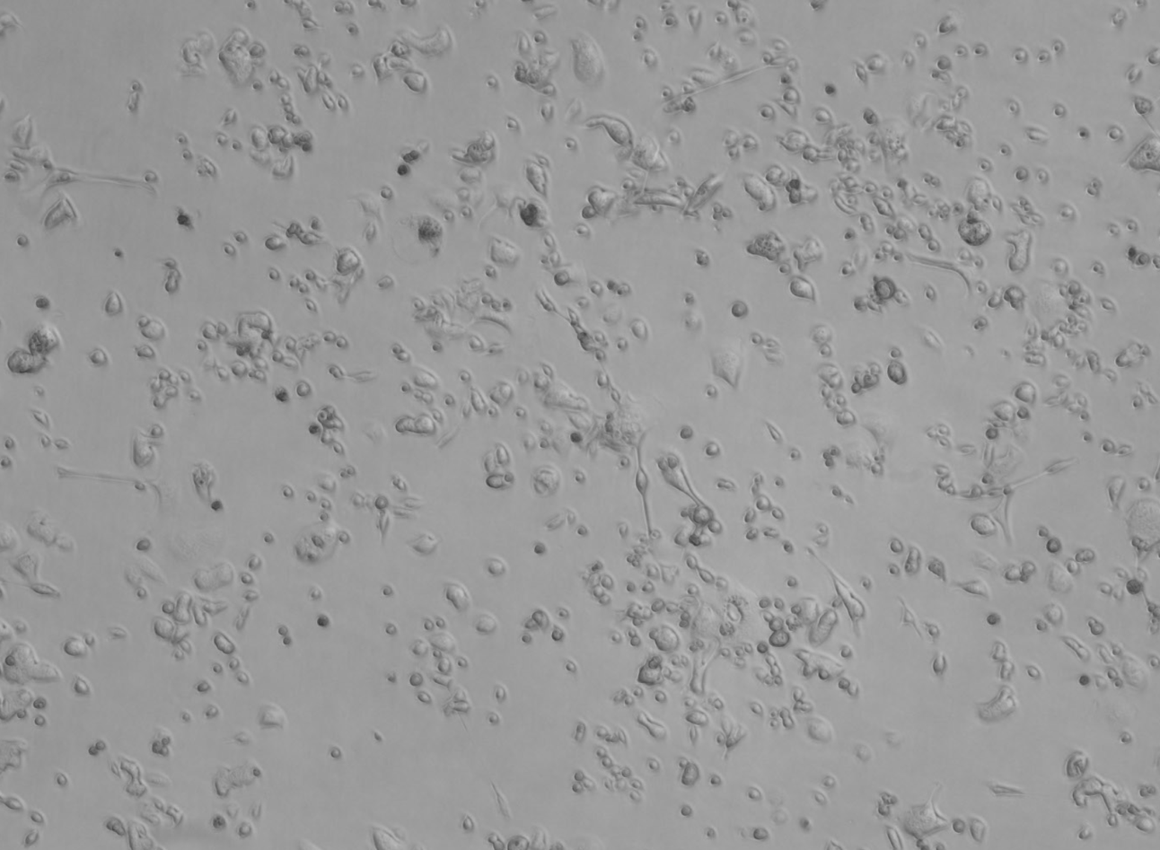
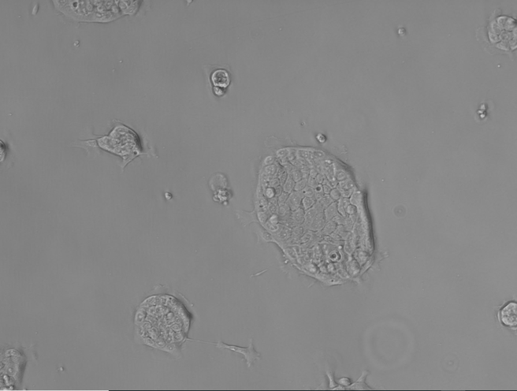
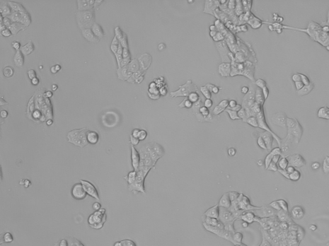
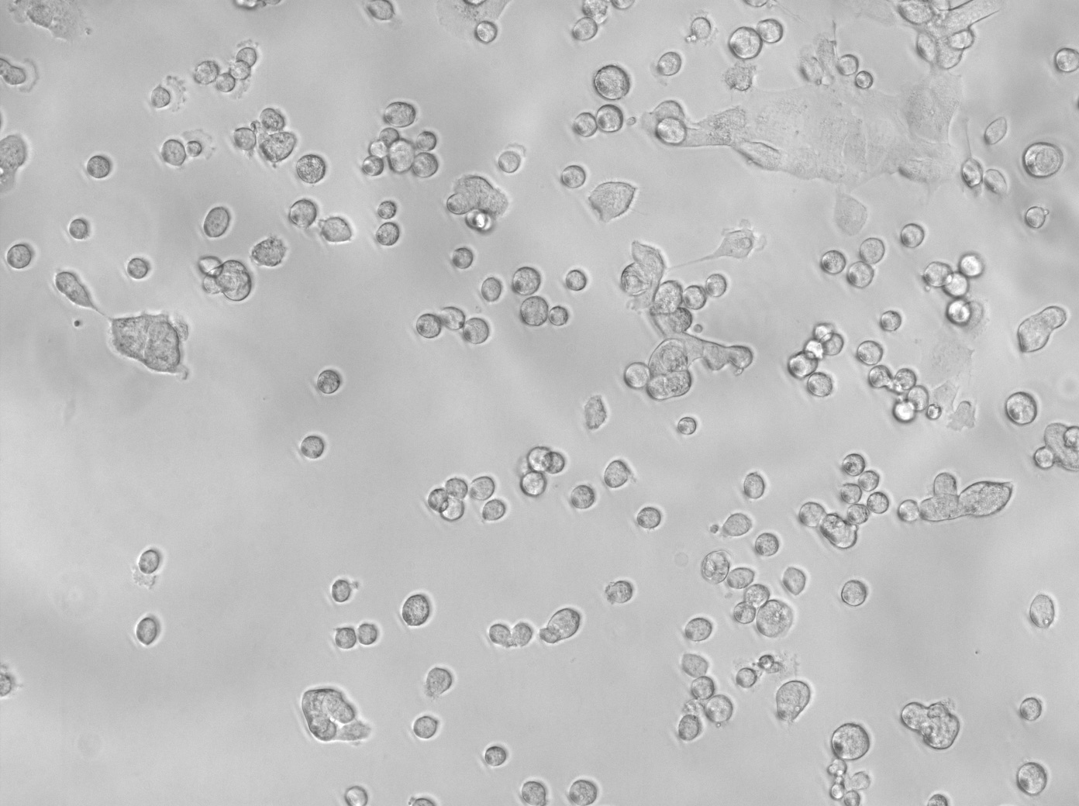
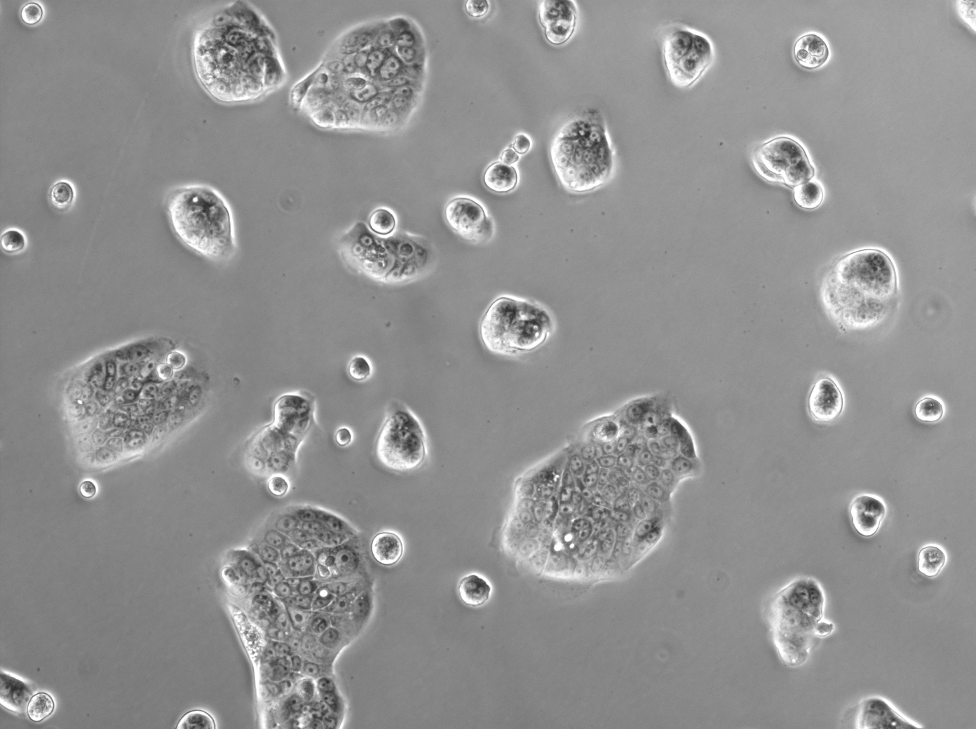
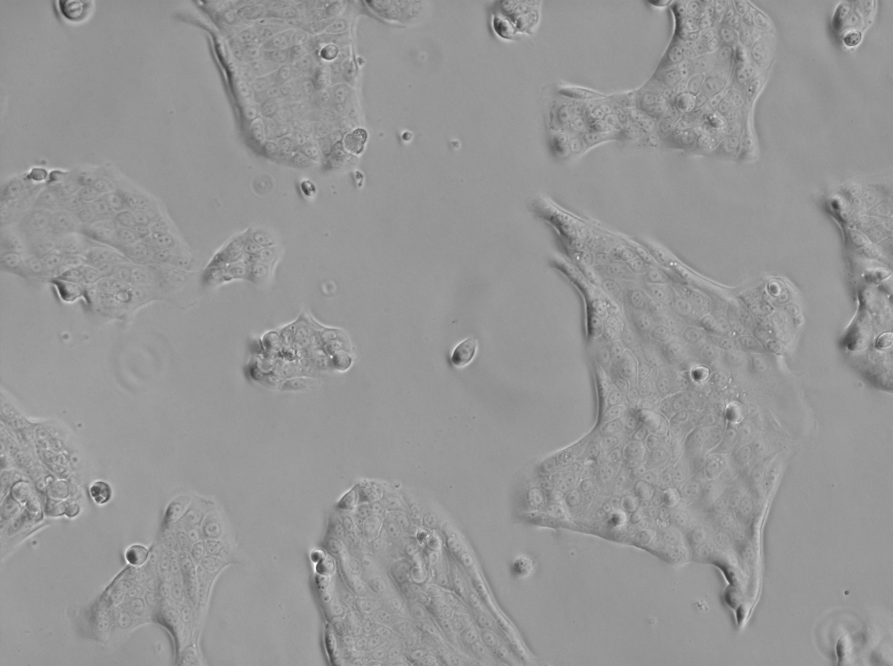
Data Used - Bright Field Images
Training Set
3 Commercially Cell Lines
ASPC1 - Meschemyal
CAPAN2 - Epithelial
PANC1 - Epithelial
Testing Set
3 Internally Generated Cell Lines
PATC53 - Meschemyal
PATC124 - Quasi-Mesenchymal
PATC69 - Epithelial
Notes:
Sanjana

Slide 6
Approach
Image segmentation
Masking both training and testing set to extract features
Feature Selection
Neighborhood Component Analysis (NCA) to identify segmentation features contributing most to differences in the training set
Model Training
Classification Learner on properties of masked cell pictures defined as either Meschemyal or Epithelial
Notes:
Sanjana

Slide 7
Approach
Classification Learner and NCA on properties of masked cell pictures defined as either Meschemyal or Epithelial
Total Image (Didn’t Work)
Average Connectivity
Minimum Centroid Distance
Average Centroids Per Cluster
Percent of Centroids in Cluster
Individual Mask Area
9 Regionprops
Eccentricity
Centroid Counts
Ratio of Perimeter to Area
Centroids Per Pixel
Normalized Mean Intensity
Ratio of Area to Convex Area
Notes:
Frank

Slide 8
Image Segmentation

Slide 9
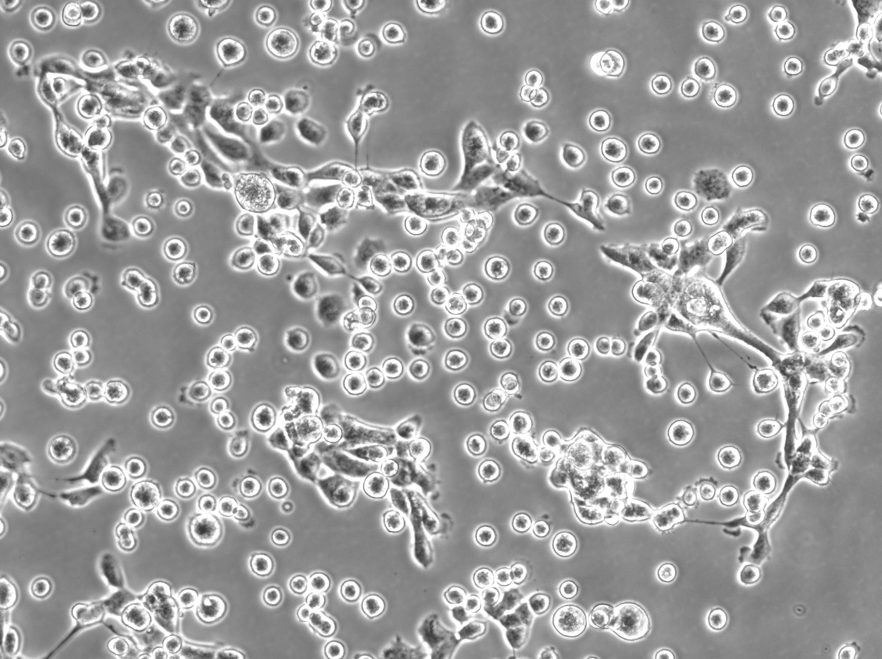
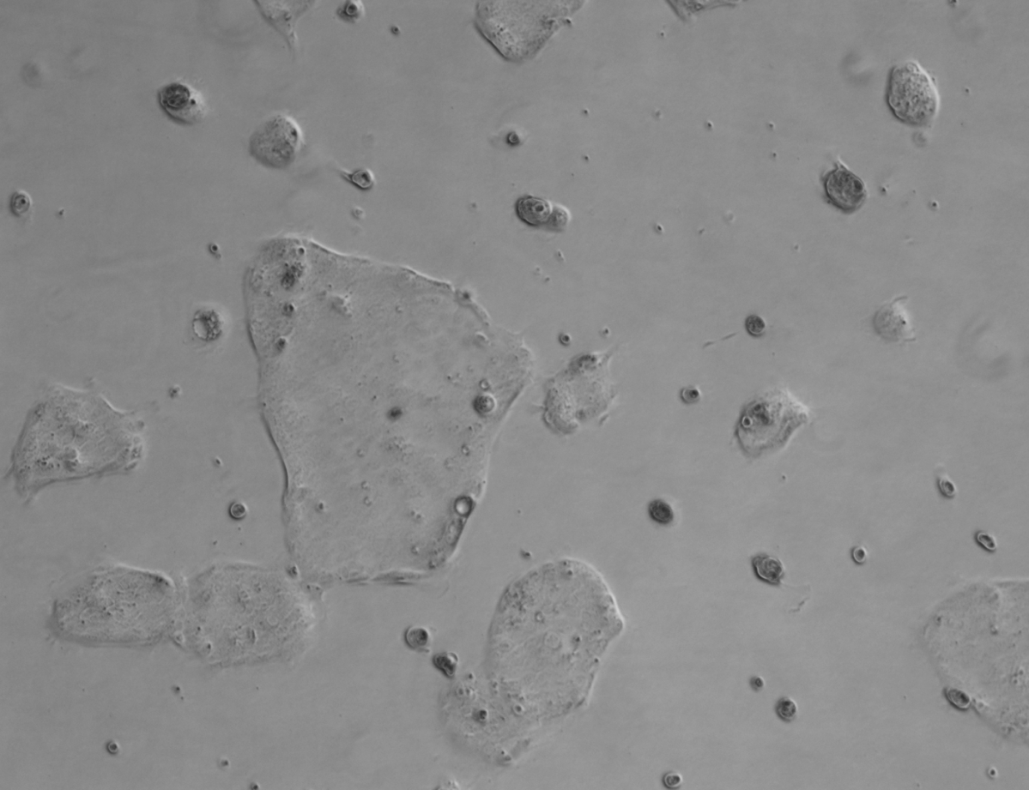
Masking
Masking Cells in Colonies is hard...
Notes:
Frank

Slide 10
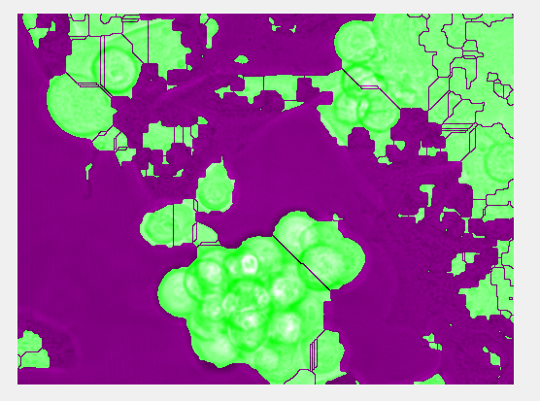
Masking
Masking Cells in Colonies is hard...
Notes:
Frank
We tried several methods in class, and we additionally, watershed, ilastik etc. Ilastik wasnt used due to the poor image quality was not very good.

Slide 11
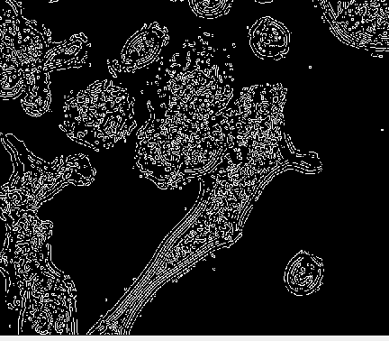
Masking
Masking Cells in Colonies is hard...
Notes:
Frank Weighted Centroids of edge generated of normalized image, it might be indicative of where the cells are located.

Slide 12
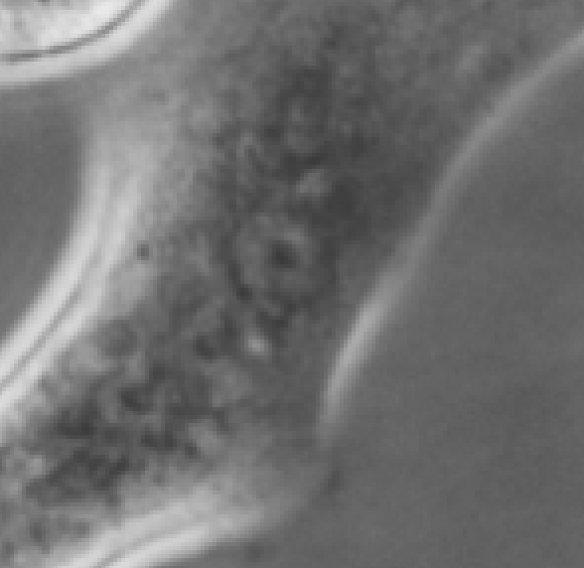
Masking
Masking Cells in Colonies is hard...
Notes:
Frank

Slide 13
Masking
Weighted Centroid of Edge Mask
Notes:
Frank

Slide 14
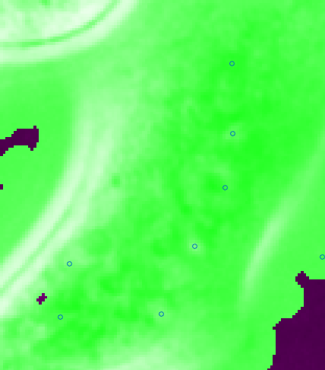
Masking
Weighted Centroid of Edge
Notes:
Frank

Slide 15
Model Training - First Pass

Slide 16
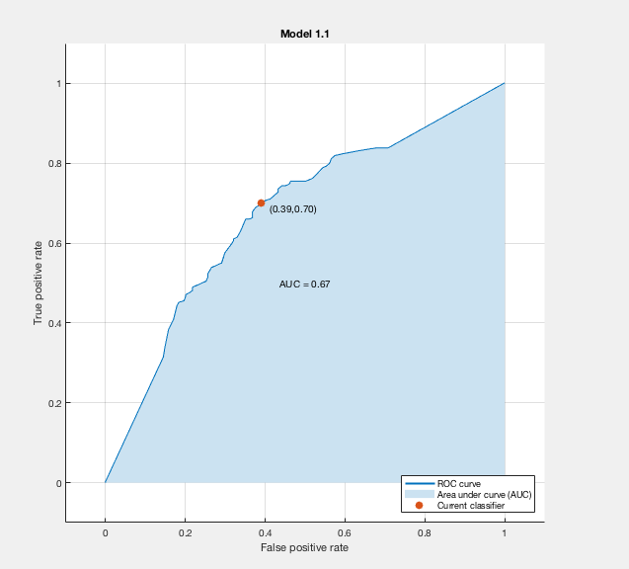
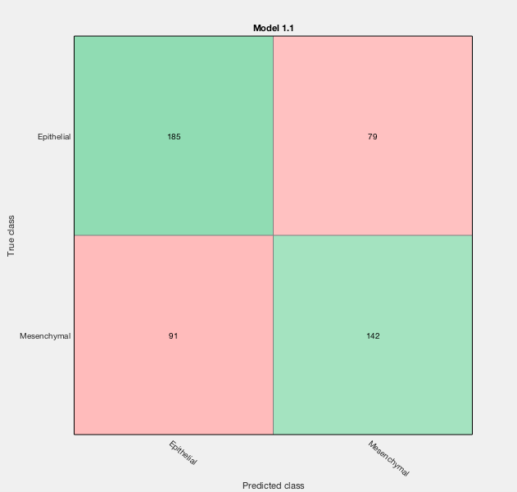
Results Classification Learning
5 - Fold Classification for Model Creation
“All Models are wrong, but some are useful”
Ran all model types - Used model with highest accuracy
Initial Classification Model - Ensemble Bagged Trees (70.8%)
Notes:
Frank 5- fold classification, to avoid overfitting
Individual decision trees tend to overfit. Bootstrap-aggregated (bagged) decision trees combine the results of many decision trees, which reduces the effects of overfitting and improves generalization.

Slide 17
Results Classification Learning
5 - Fold Classification for Model Creation
Ran All Model Types
“All Models are wrong, but some are useful”
Initial Classification Model - Ensemble Bagged Trees (70.8%)
Notes:
Frank

Slide 18
Running Model on Test Image Cells
Cell Line | Epithelial Count | Meschemyal Count
PATC53 (Meschemyal) | 280 | 143
PATC69 (Epithelial) | 610 | 205
PATC124 (Mixed) | 227 | 59
Notes:
Frank

Slide 19
Feature Selection

Slide 20
Neighborhood Component Analysis
Non-parametric supervised learning technique for feature selection - maximizes accuracy of classification algorithms
Learns the “feature weights” for all features in the training data and maximizes these by regularizing
Ran it first with default settings and evaluated classification loss
Ran with different Lambda values (regularization parameter) to minimize classification error by a multiple of 1/n.
Notes:
Sanjana

Slide 21
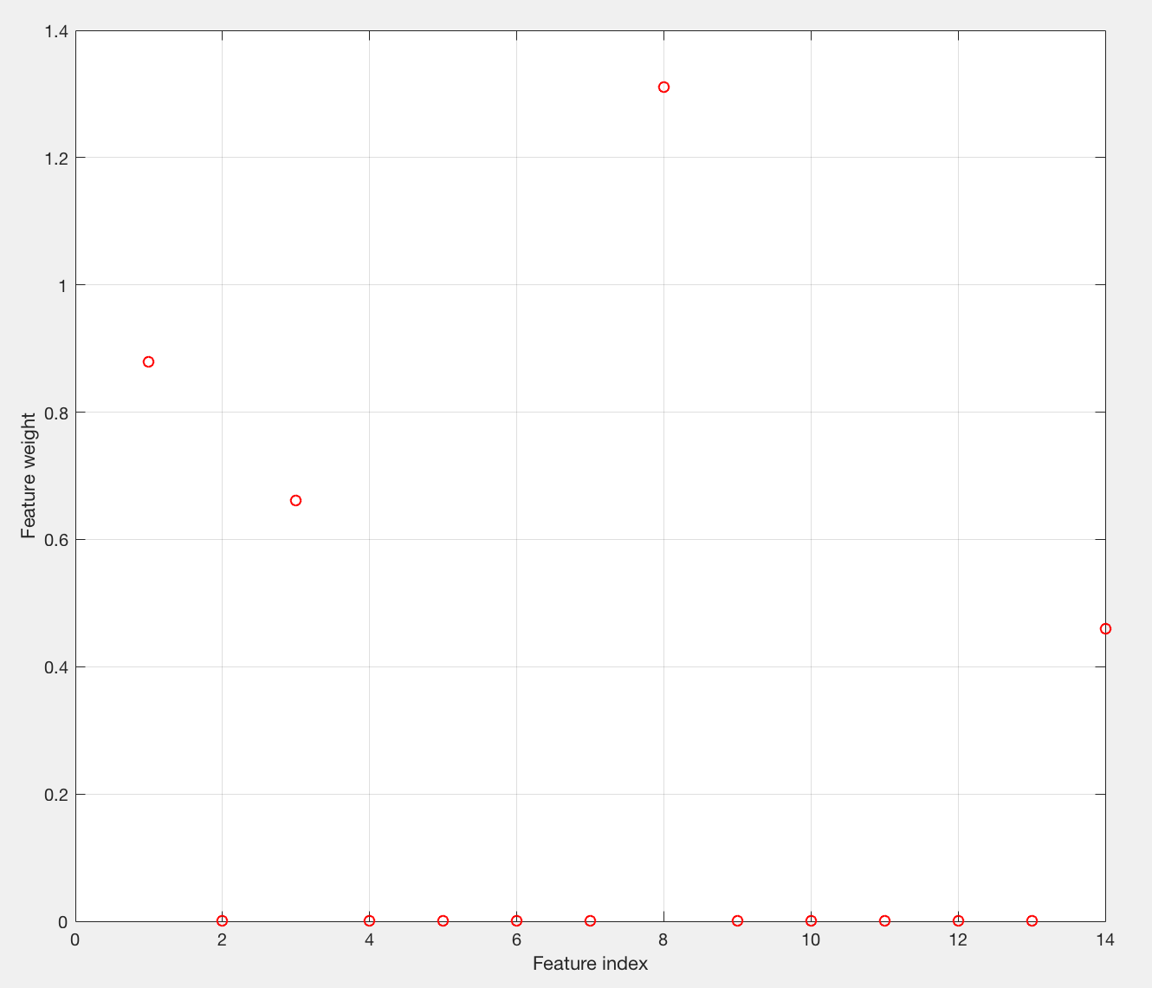
NCA with Default Parameters
Four of 14 features identified
Area
Orientation
Perimeter
Mean Area per Nucleus

Slide 22
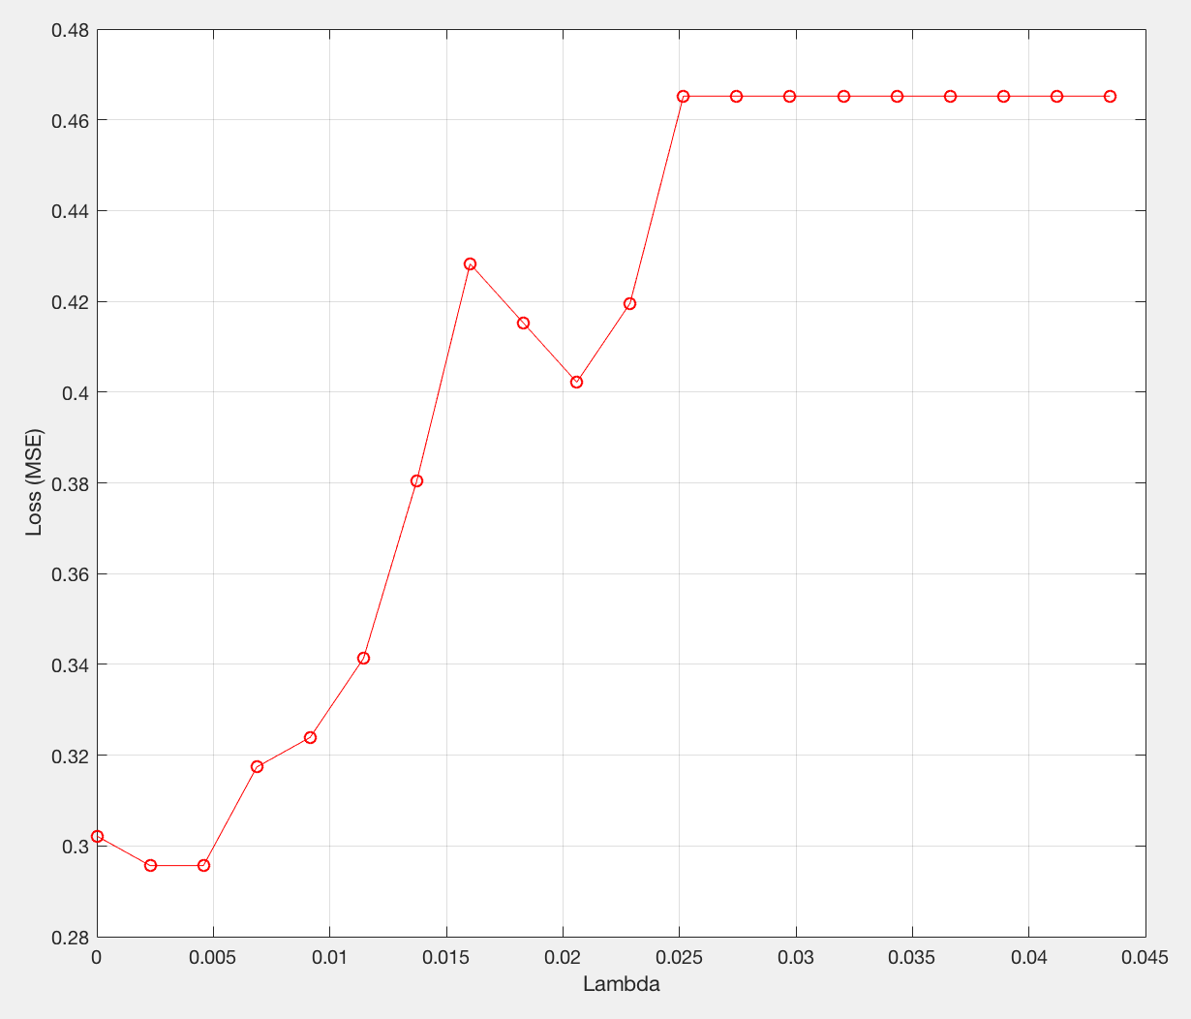
Identifying best Lambda Value
Five fold cross validation to partition ⅕ of the training data into testing
Iterated through each fold, and computed the loss value at each lambda value (increment of 1/n)
Took the mean of the loss across the five folds
Best lambda = 0.0023
Minimum loss = 0.2597

Slide 23
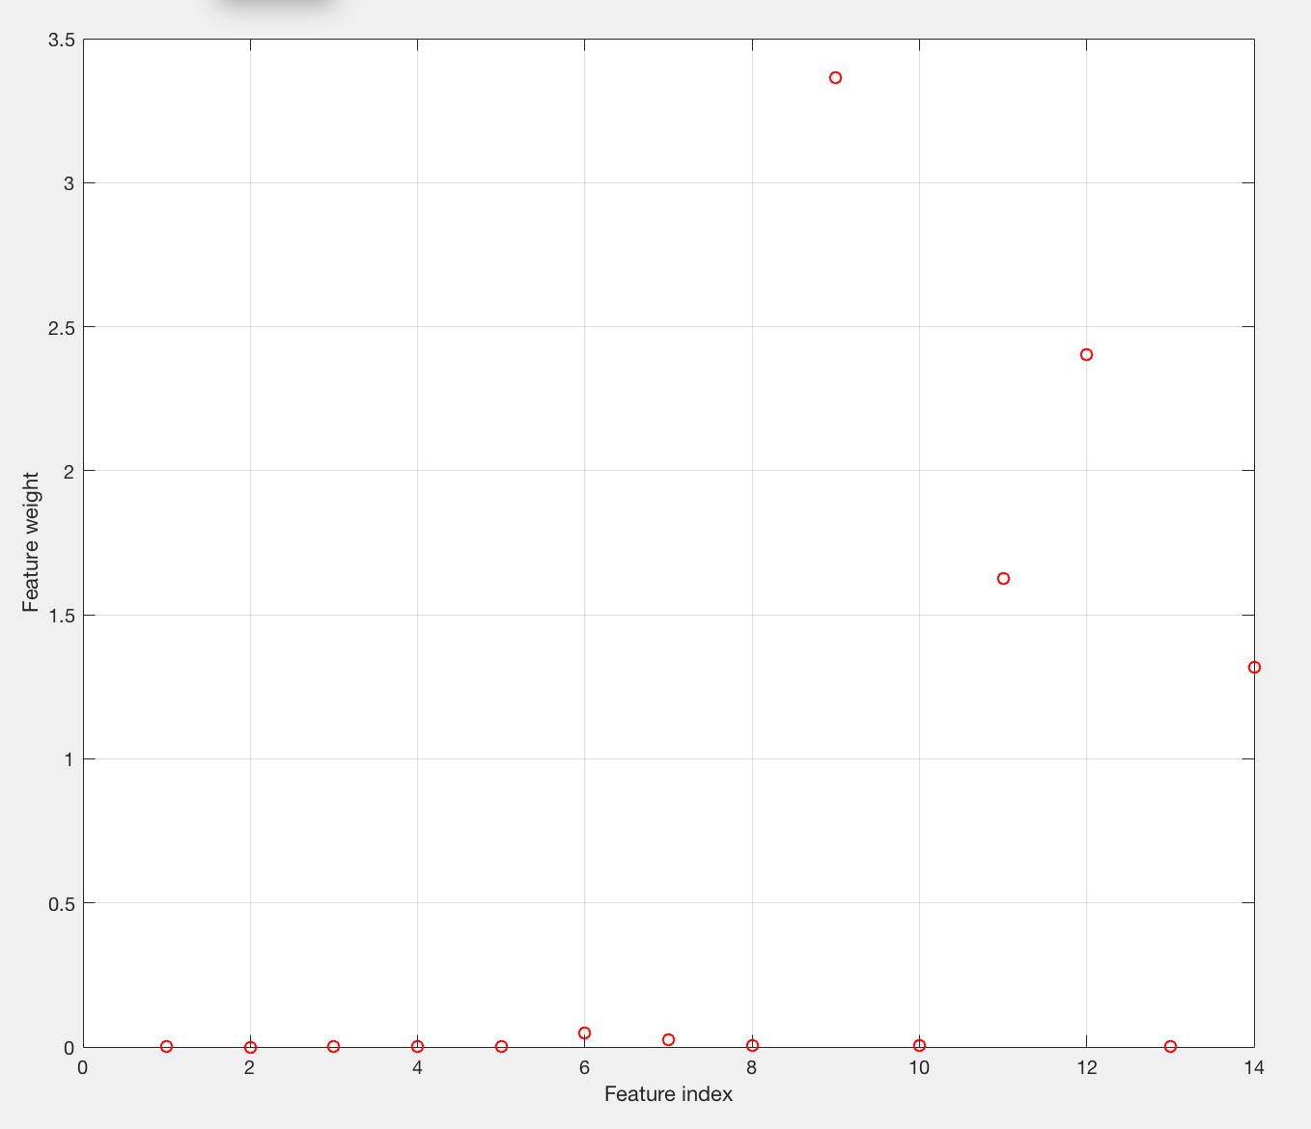
Feature Selection with Loss Minimized
Four of 14 features identified
Mean Intensity
Mean Centroids
Area to Perimeter Ratio
Mean Area per Nucleus

Slide 24
Model Training using Select Features

Slide 25
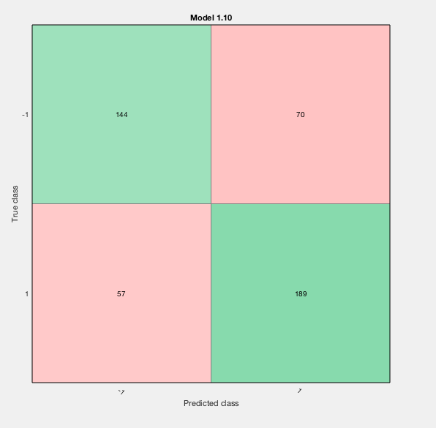
Results Classification Learning 2
5 - Fold Classification for Model Creation
4 Features Used
Mean Intensity
Mean Centroid per Cell Mask
Area/Perimeter Ratio
Area Per Centroid
Final Classification Model - Quadratic SVM (72.4%)
Notes:
Frank, support vector machine using quadratic function optimization. Accuracy Increases. Honestly If you run these at different times, the accuracy varies, rarely did we see over 73%

Slide 26
Running Model on Test Image Cells 2
Improvement!!! Red - Count went up. Blue - Count went down.
Cell Line | Epithelial Count | Mesenchymal Count
PATC53 (Mesenchymal) | 253 | 170
PATC69 (Epithelial) | 734 | 81
PATC124 (Mixed) | 254 | 32
Notes:
Frank

Slide 27
Discussion
Images are of low quality
Cell lines are truly mixed, not binary
Need more segmented images
Training Set is uneven (5 Mesenchymal vs 9 Epithelial)
Some images were thrown out - defeats purpose
Notes:
Frank

Slide 28
Conclusions
Model Improvement
Image Analysis to differentiate the two is possible!
Our model is not robust for actual use using current parameters
Images with better microscopy or staining may be more salient features
Develop a scoring metric based to classify mesenchymal transition on a continuum rather than on a binary basis
Notes:
Frank

Slide 29
Thank you!
Happy to take any questions
Notes:
Only Sanjana

